Slide 1
Institutional Repository at TU:
Plagiarism and Copyright Issues
Mr. Bijaya Sharma
Ms. Chumban Gautam

Slide 2
Structure of Presentation
Introduction to Institutional Repositories (IR)
Understanding Plagiarism
Copyright Fundamentals
Ethical Practices for Building an IRs

Slide 3
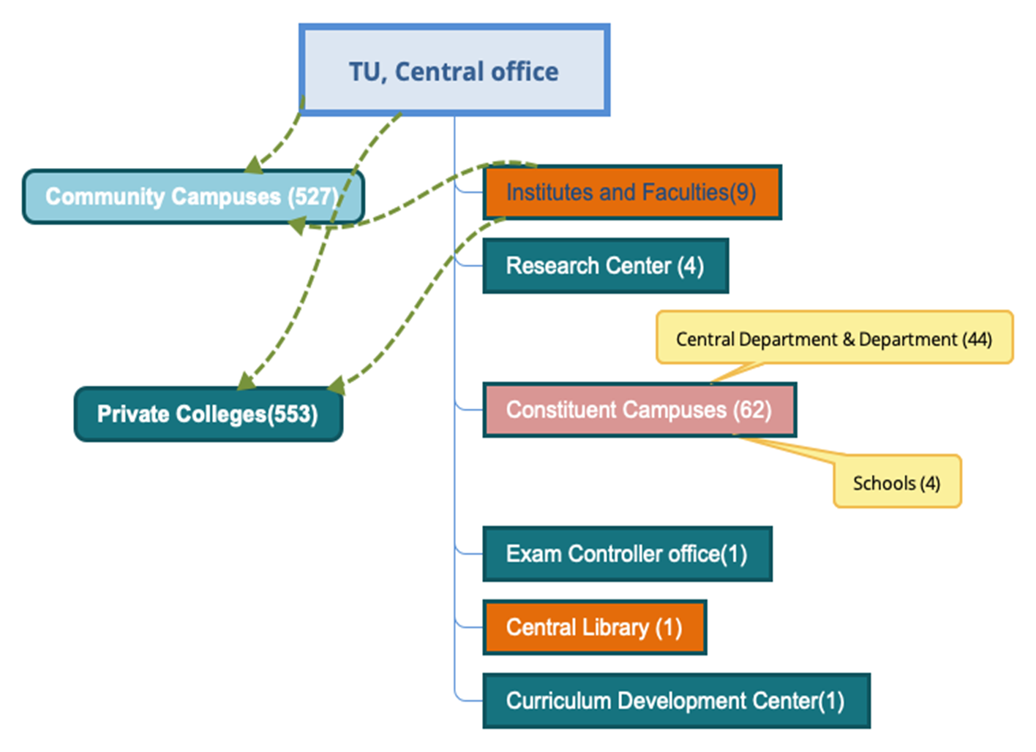
Institutional Repositories of TU
The TU Central Library has played a leading role in implementing Institutional Repositories (IRs) to manage, preserve, and disseminate academic and research achievements, while also developing and expanding effective library services across all units of Tribhuvan University.

Slide 4
Copyright and Plagiarism for IRs
Provide appropriate permissions and licenses,
Responsible Research and Publishing Practices,
Preventing Academic Dishonesty,
User and Contributor Assurance,
Preservation of IPRs,
Builds trust among users and contributors etc.

Slide 5
Plagiarism
Use of others' intellectual property (ideas, words, or work) without any permission of the creator and present them as new and original work. It is a serious crime seen in the academic field.

Slide 6
Copyright
Copyright is a legal right that protects creators/ authors of literary and artistic works, giving them exclusive control over the use of their published or unpublished content in any fixed form.

Slide 7
How can we enjoy copyrighted works legally?
Purchasing their contents through authorized platforms.
Seeking permission from the copyright owner for use.
Exploring creative commons-licensed works, which allow certain uses without direct permission.

Slide 8
Similarities in plagiarism and copyright violation
Plagiarism and copyright violation both involve the improper use of someone’s original work
Both involve using someone else's intellectual property without proper permission.
Both can harm the original creator by depriving them of credit or financial benefits.
Both can lead to consequences, such as reputational damage or legal action

Slide 9
Differences between plagiarism and Copyright violence
Plagiarism
Passing of someone else work as their own without credit.
Not legal, but unethical
Giving credit to the original creator
Academic penalties, loss of credibility
Usually intentional
More ethical issue and often enforced in academic and professionals settings
Copyright violation
Using copyrighted materials without permission
Illegal and can lead lawsuit or fine
Protecting the creator’s rights to control their works
Legal penalties, financial damage
Can be accidental or intentional
A legal violation matter

Slide 10
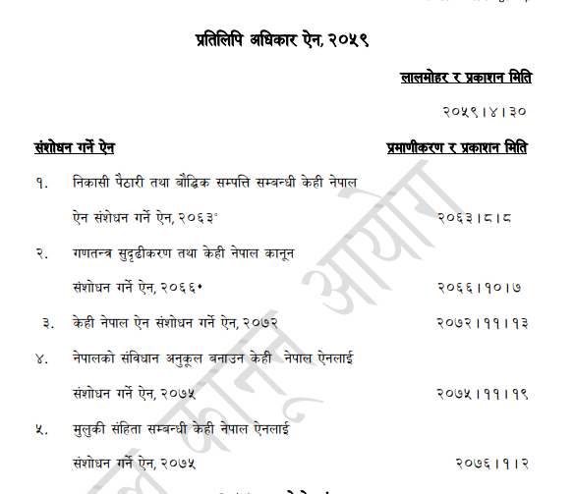
^{Protectable subject matters}
Any article, essay, story, poem, novel, epic, lyric or any kinds of books, etc. as a whole or a part,
Any drama or cinema,
Any drawing, map, photograph,
Any musical notations, sound records,
Any other works related to literature, music or art etc.
Sources: (Copyright Act, 2059)
(https://rb.gy/sfijaa)

Slide 11
^{Terms of protection}
Life long and 50 years after death for literary works,
50 years for performer, sound recording, producer and broadcaster,
25 years for architect design, photographic work and applied art.
Sources: Copyright Act, 2059

Slide 12
Provision of using copyright materials
^{without authorization}
Reproduction allowed for personal purpose
Citation allowed
Reproduction allowed for teaching and learning
Reproduction by library and archive
Reproduction, broadcast and other communication allowed for purpose of information to the general public
Reproduction of computer program
Public exhibition allowed
Sources: Copyright Act, 2059

Slide 13
Research Misconduct
It is defined as:
Fabrication
Falsification
Plagiarism
Harmful activity
Does not include honest error or differences of opinion.
(UGC Nepal, 2018)

Slide 14
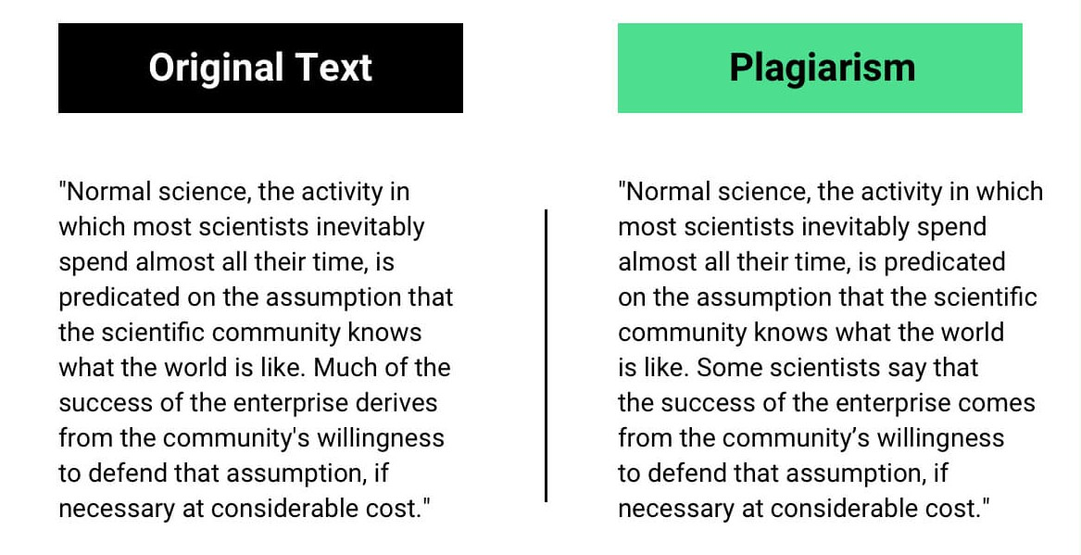
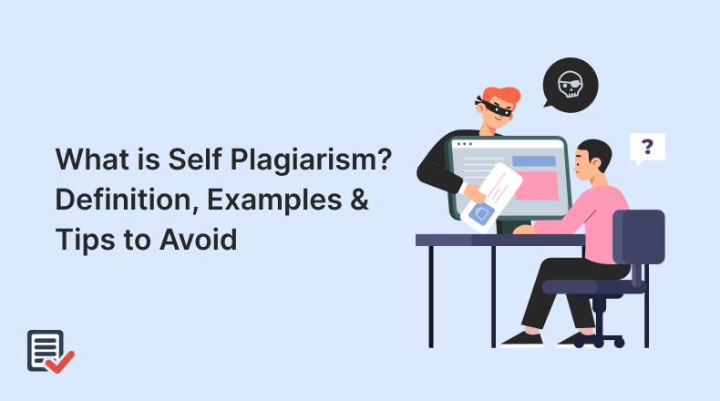
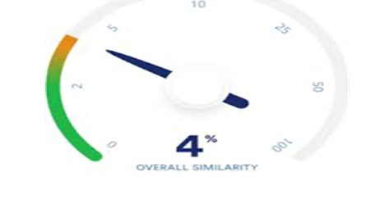
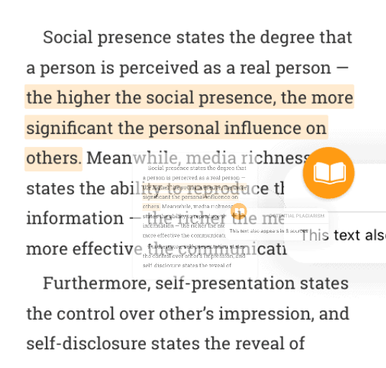
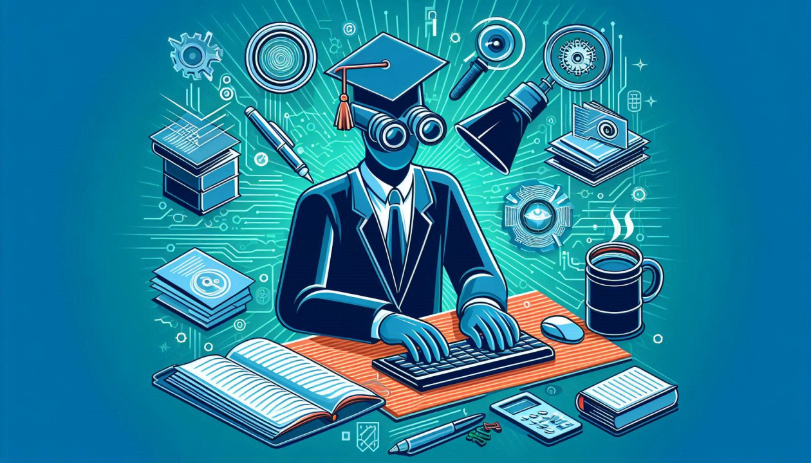
Some Common forms of Plagiarism
1. Direct plagiarism
2. Self - Plagiarism
3. Mosaic Plagiarism
5. Accidental plagiarism
4. Graphic plagiarism
Sources: https://rb.gy/i99ih1

Slide 15
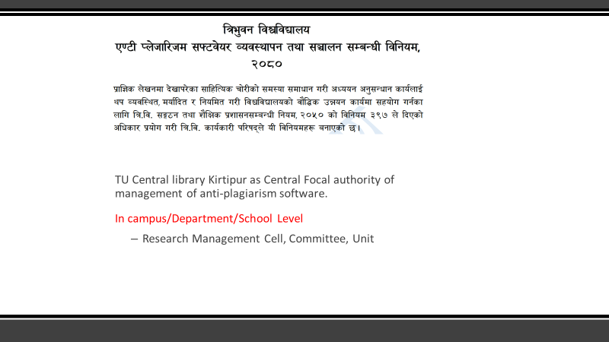

Slide 16
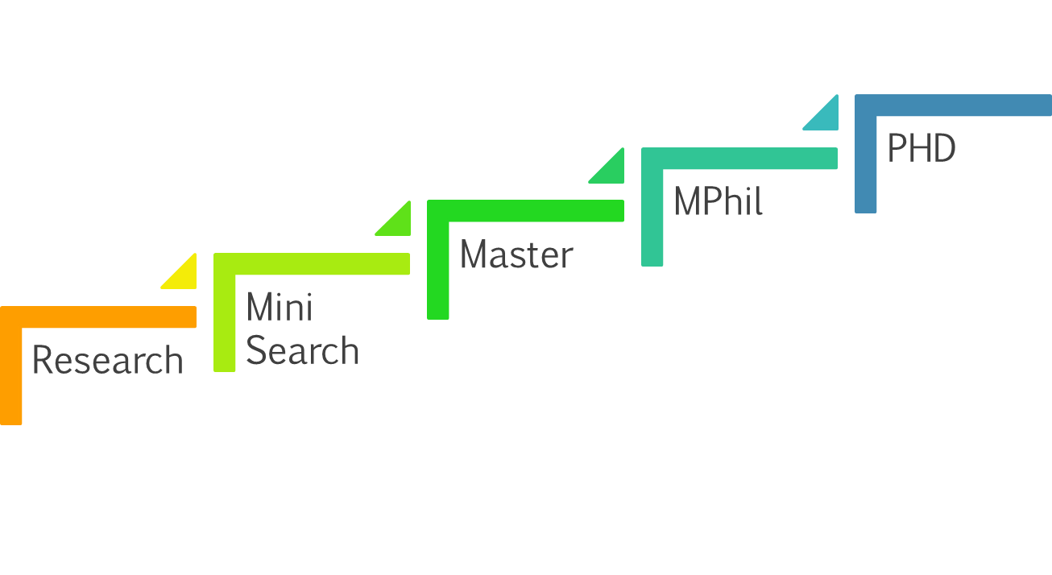
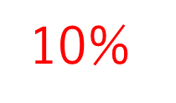
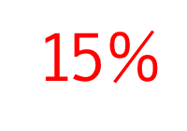
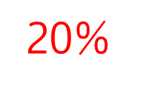
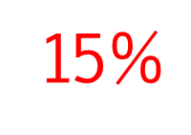
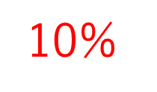
Tolerance limit of Similarity Index
  Sources: TU Anti-Plagiarism Software Management and Operation Procedure, 2080

Slide 17
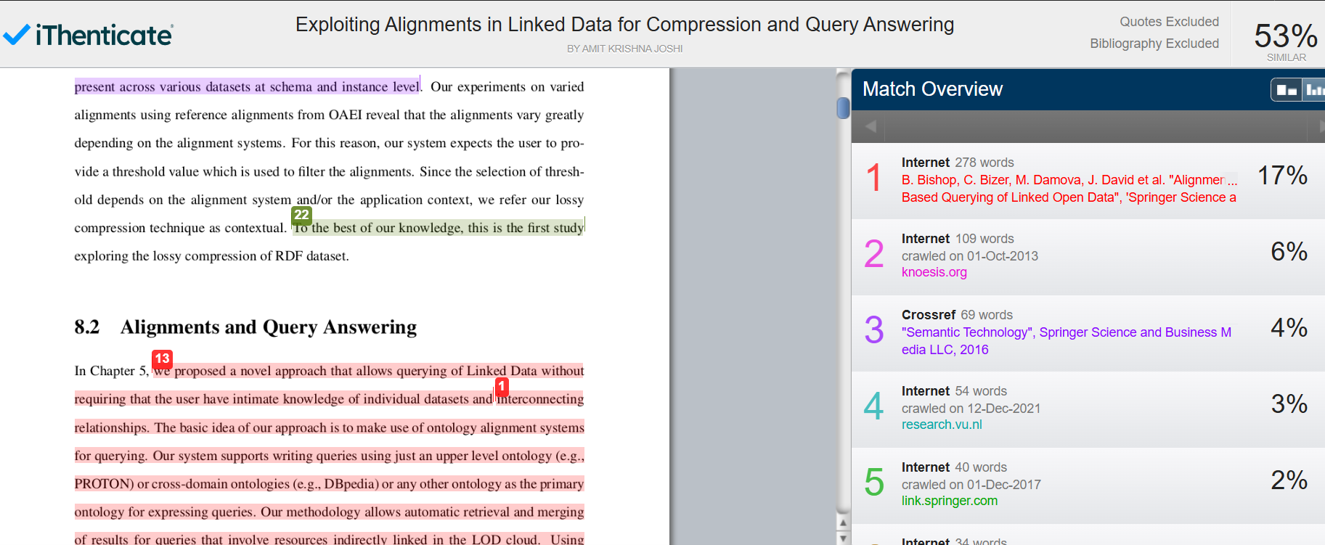
Key Aspects of Plagiarism Checking
Text Comparison
Similarity Reports
Source Identification
Paraphrase Detection
AI Intergration
Multilingual Support

Slide 18
Ethical Practices for Building an IRs
Aware the institutional norms and standards​,
Obtain written consent,
Accept content without bias,
Confirm copyright ownership,
Anonymize sensitive/confidential data,
Follow TU’s metadata guidelines etc.

Slide 19
Useful Rules
National Laws & Policies:
  Copyright Act, 2059 (Nepal)
  National Intellectual Property Policy, 2017
Organizational Guidelines (TU):
  TU Research Ethics Review Procedure, 2078 (Revised 2081)
  TU Digital Library Management Guideline, 2078
  TU Anti-Plagiarism Software Management and Operation Procedure, 2080
  UGC Policy on Research Misconduct, 2018

Slide 20
The Way Forward
Make Creative commons licenses,
Formulate clear institutional policies,
Create auto citation and reference systems,
Promote a culture of digital publication,
Conducted regular awareness and capacity building,
Make user-friendly community & collection, etc.

Slide 21
References
•Dhammi, I. K., & Ul Haq, R. (2016). What is plagiarism and how to avoid it?. Indian journal of orthopaedics, 50(6), 581–583. https://doi.org/10.4103/0019-5413.193485
•Erkaya, O. R. (2009). Plagiarism by Turkish students: Causes and solutions. Asian EFL journal, 11(2), 86-119.
•Kumar, P. M., Priya, N. S., Musalaiah, S., & Nagasree, M. (2014). Knowing and avoiding plagiarism during scientific writing. Annals of medical and health sciences research, 4(3), 193-198.
Law Commission Nepal. (2002). The Copyright Act, 2002. https://lawcommission.gov.np/content/12916/12916-the-copyright-act-2002/
•Pandey,R.K. (2078). Digital Library Theory and Practices [PowerPoint slides]. Popular Digital Library Database(Repository)
•Pecorari, D. (2013). Teaching To Avoid Plagiarism: How To Promote Good Source Use: How to Promote Good Source Use. McGraw-Hill Education (UK).
Reverbico. (n.d.). 13 types of plagiarism with examples. Reverbico. https://reverbico.com/blog/types-of-plagiarism/
•Sadruddin, M. M. (2021). Exploring the Causes of Plagiarism among Post Graduate Research Students--A Phenomenological Case Study Approach. Journal of Education and Educational Development, 8(2), 296-318.
TU Research Division (2078). TU Research Ethics Review Procedure, 2078 (Revised in 2081). Author
•Tribhuvan University Central Library. (2080).TU Anti-plagiarism software management and operation procedure. Author.
•University Grand Commission (2018). The UGC Policy Regarding Research Misconduct, 2018. Author
• Images retrieved from Google

Slide 22
